Slide 1
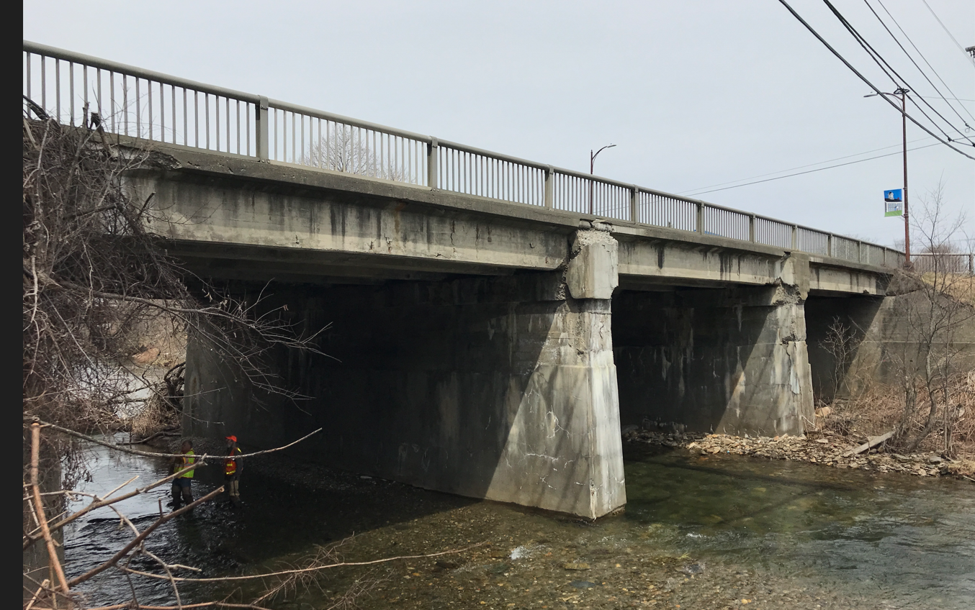

Northfield Village BF 0241(58)
Project Update – Preliminary Plans
Vermont Route 12 – Bridge #60 over Dog River
August 12, 2025

Slide 2

Introductions
Gary Laroche, P.E.
VTrans Consultant Project Manager
Alan Legacy
VTrans Utilities Coordinator
Mike Keedy
VTrans Project Contamination Engineer
Nancy Avery, P.E.
VTrans - Work Zone Safety Engineer

Slide 3
Meeting Overview
VTrans Project Development Process
Project Location
Existing Conditions
Project Overview (Final Plans)
Maintenance of Traffic
Contaminated Soils
Estimate
Schedule
Concurrent Construction Risk
Questions

Slide 4
VTrans Project Development Process
Initiated
Project
Funded
Project
Defined
Contract
Award
Project Definition
Project Design
Construction
Conceptual Plans Complete
Preliminary Plans Complete
Property Owner Contact
Quantify areas of impact
Environmental permits
Right-of-Way process
Final Plans, estimate and specifications
Contract Plans
Advertisement
Identify resources & constraints
Evaluate alternatives
Public participation
Build Consensus

Slide 5
Description of Terms Used (1 of 2)

Slide 6
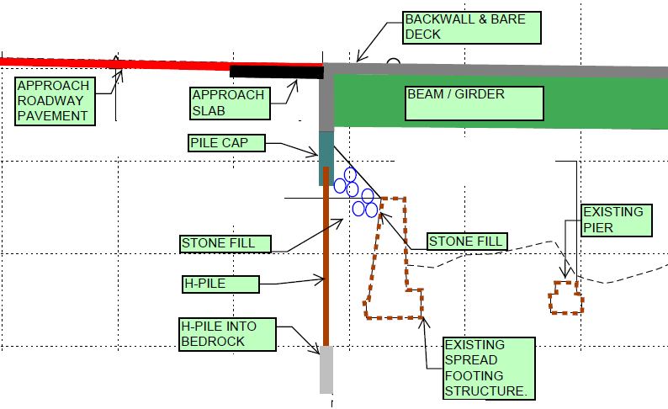
Description of Terms Used (2 of 2)

Slide 7
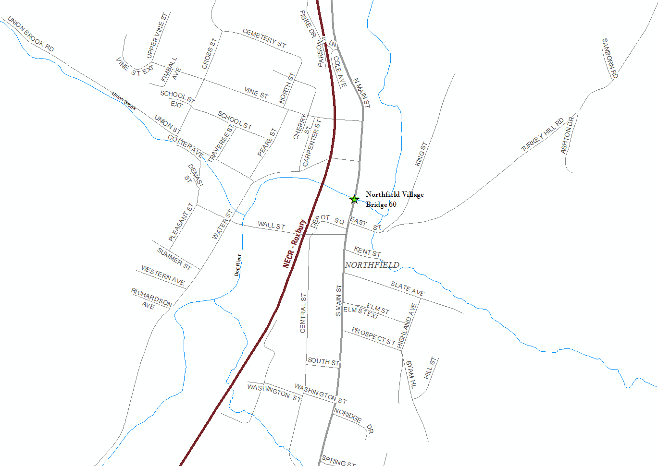
Location Map

Slide 8
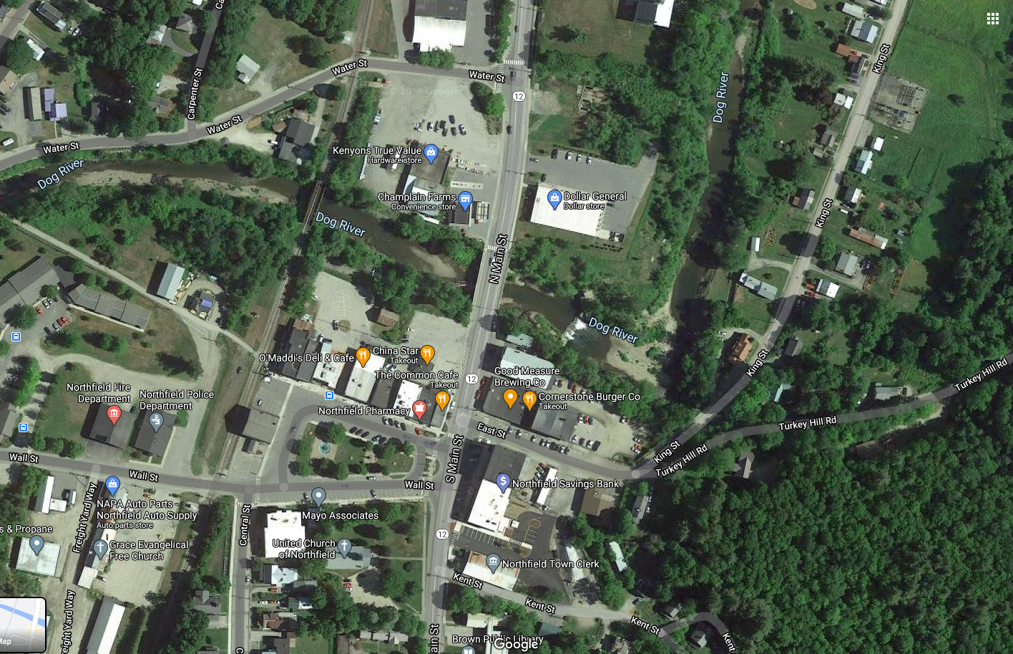
Bridge 60
Project Location

Slide 9
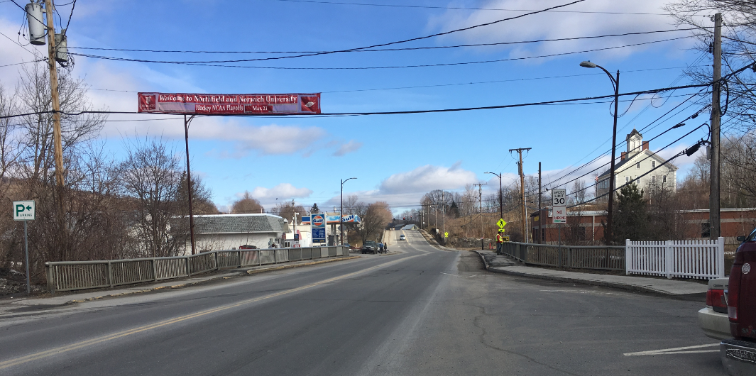
Looking North over Bridge 60
Existing Conditions
Roadway Classification – Major Collector (Class 1 TH)
Bridge Type – 111’ Long 3-Span Concrete T-Beam Bridge
Ownership – Town of Northfield
Constructed in 1926, Reconstructed in 1958 Sidewalks on both sides

Slide 10
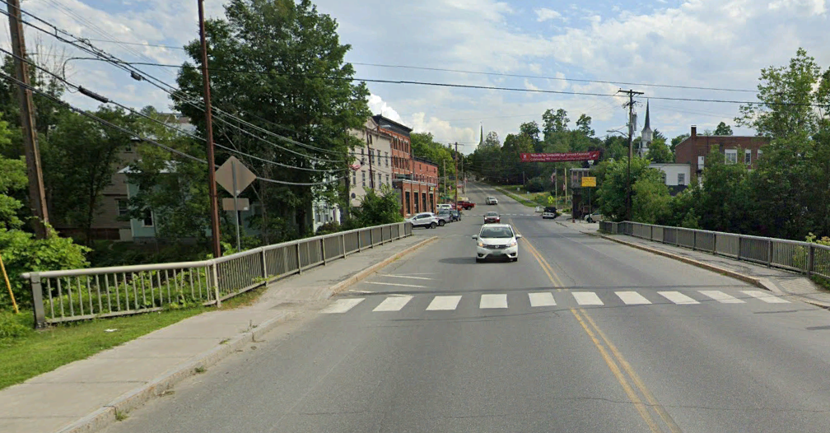
Looking South over Bridge 60
Existing Conditions
Sidewalks on both sides
Crosswalk at north end of bridge

Slide 11
Existing Conditions – Bridge #60
Sidewalks are in poor condition with heavy spalling and large delaminations
Wearing Surface is in poor condition with cracking and pothole formation
Reinforced concrete T-Beams are in fair to poor condition having areas of heavy saturation, efflorescence leakage, rust staining and spalling with delaminations and exposed rebar
Both abutments have moderate to heavy cracking with efflorescence leakage due to saturation from above. Additionally, small spalls are present in the bridge seat area below the fifth and sixth beams.
The pier seat and caps have heavy deterioration with heavy cracking, delaminations, and efflorescence leakage present. The bridge seats at both piers have heavy spalling, saturation and efflorescence leakage below the fifth and sixth beams. The pier shafts have small spalls exposing reinforcing steel along with cracking with efflorescence.
The Dog River is prone to high debris, and debris gets caught on the existing piers on a regular basis.

Slide 12
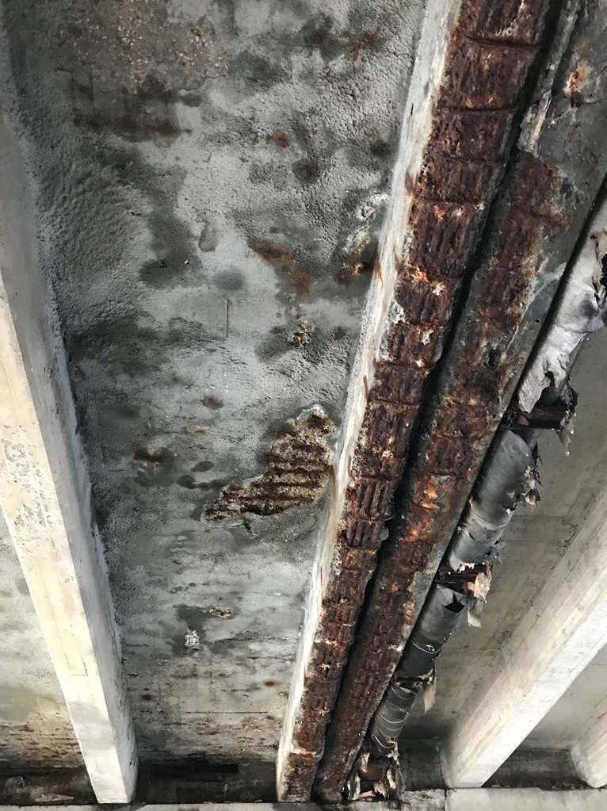
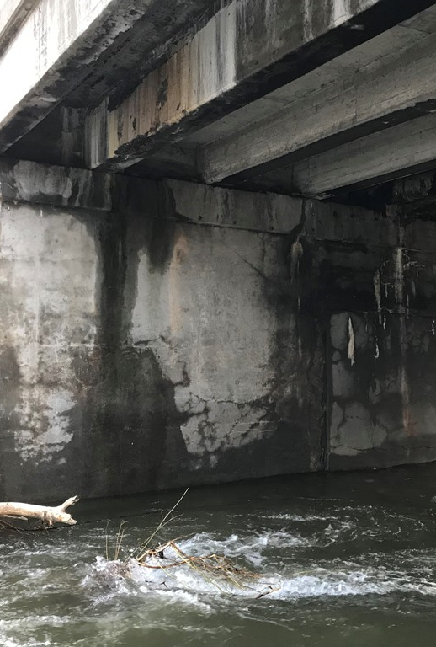
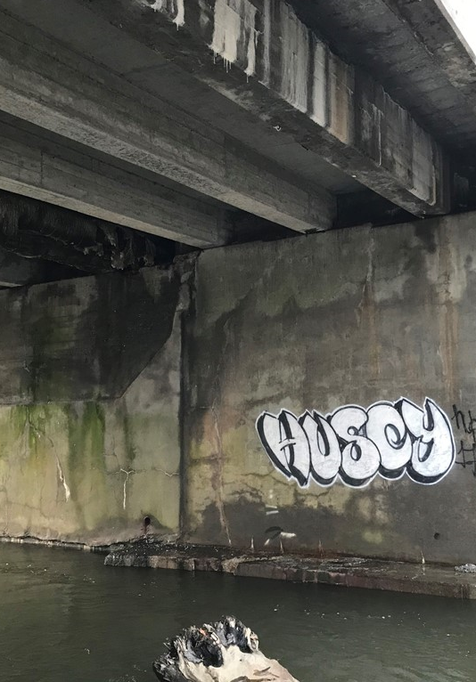
Existing Condition Ratings
Deck Rating - 5 (Fair)
Superstructure Rating - 4 (Poor)
Substructure Rating - 5 (Fair)
2025 Bridge Inspection Report:
https://resources.vtrans.vermont.gov/vtransparency/viewreport.ashx?id=1762&strucnum=200241006012132&type=structuresL

Slide 13

Project Overview (Final Plans)
Full Bridge Replacement and related approach and channel work while maintaining Traffic on an offsite detour (75-year design life)
  Site Layout
  Typical Section
  Design Characteristics
  Utility Relocation
  Bridge Lighting
  Maintenance of Traffic

Slide 14
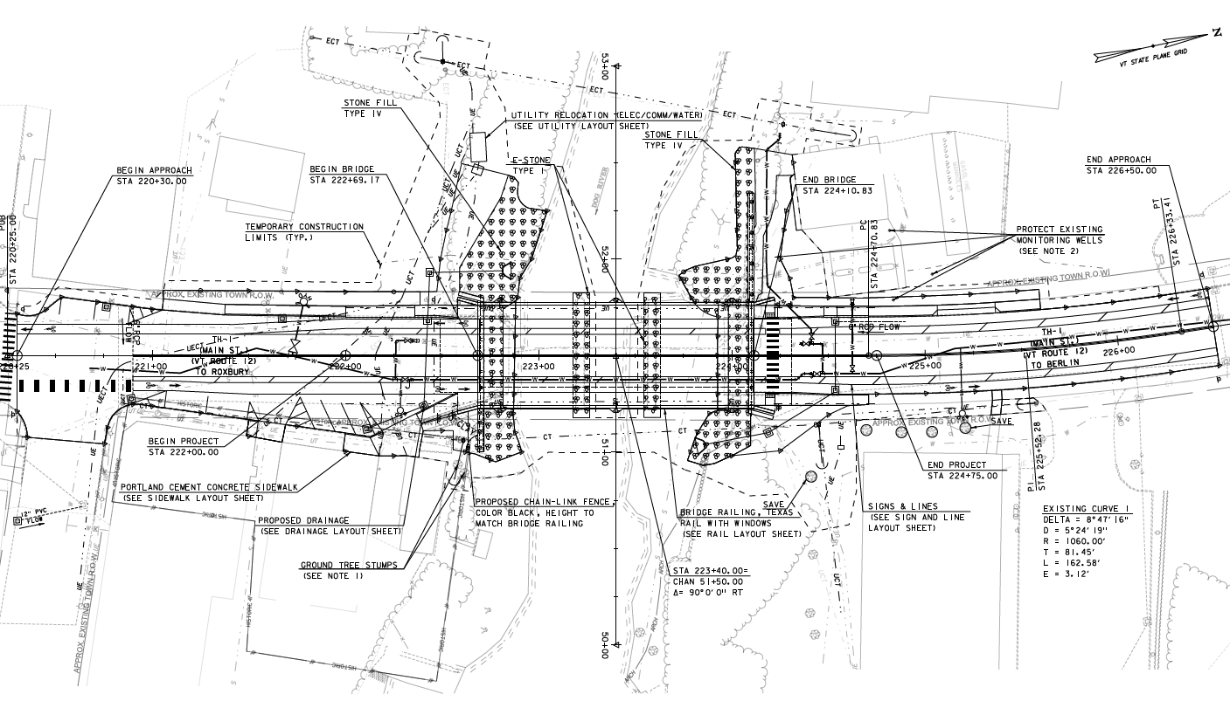
Bridge Replacement Layout
Bridge Replacement:
All new bridge components
Bridge: 8’-11’-11’-8’ Typical with 7’ wide sidewalks
Project approaches: East St. to DG.

Slide 15
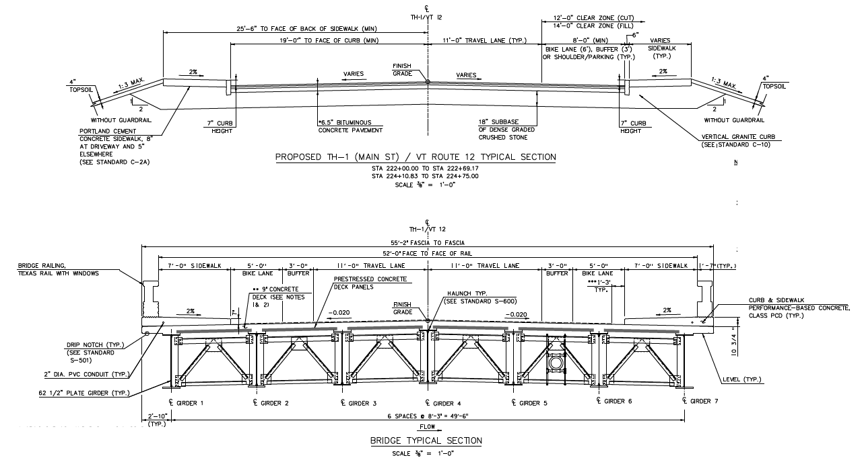
Full Bridge Replacement: Roadway/Bridge Typical Sections
Buffered Bike Lanes
11’ Travel Lanes
8’ Shoulder divided to a 5’ Bike Lanes and 3’ Striped Buffers
7’ Sidewalks (Nose of curb to face of bridge railing)

Slide 16
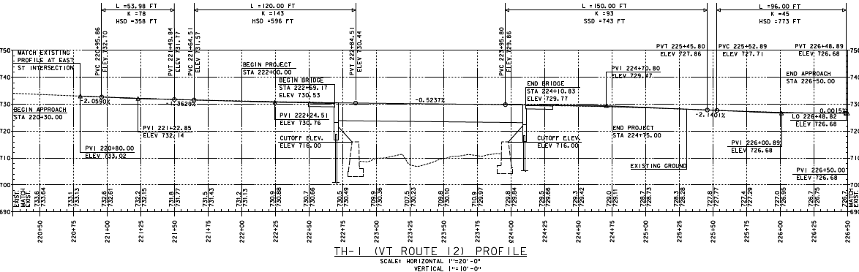
Proposed Profile
Closely match existing vertical alignment of VT-12
Existing abutments removed to elevation 716
Piers completely removed from channel

Slide 17
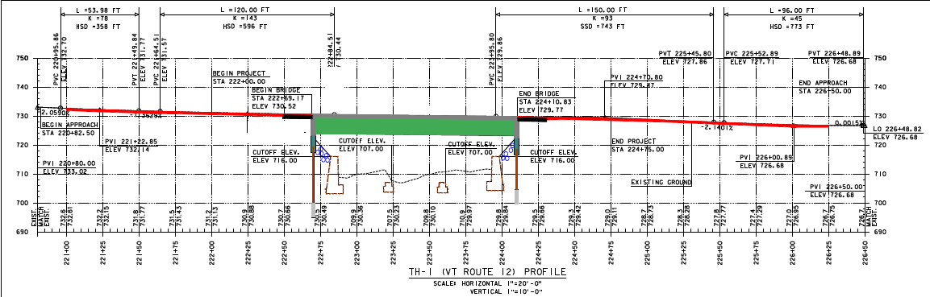
Proposed Structure
  140’ Single span steel I-Girder superstructure founded on integral abutments (VTrans preferred bridge type)
  Deep H-Pile foundation will be socketed into bedrock

Slide 18
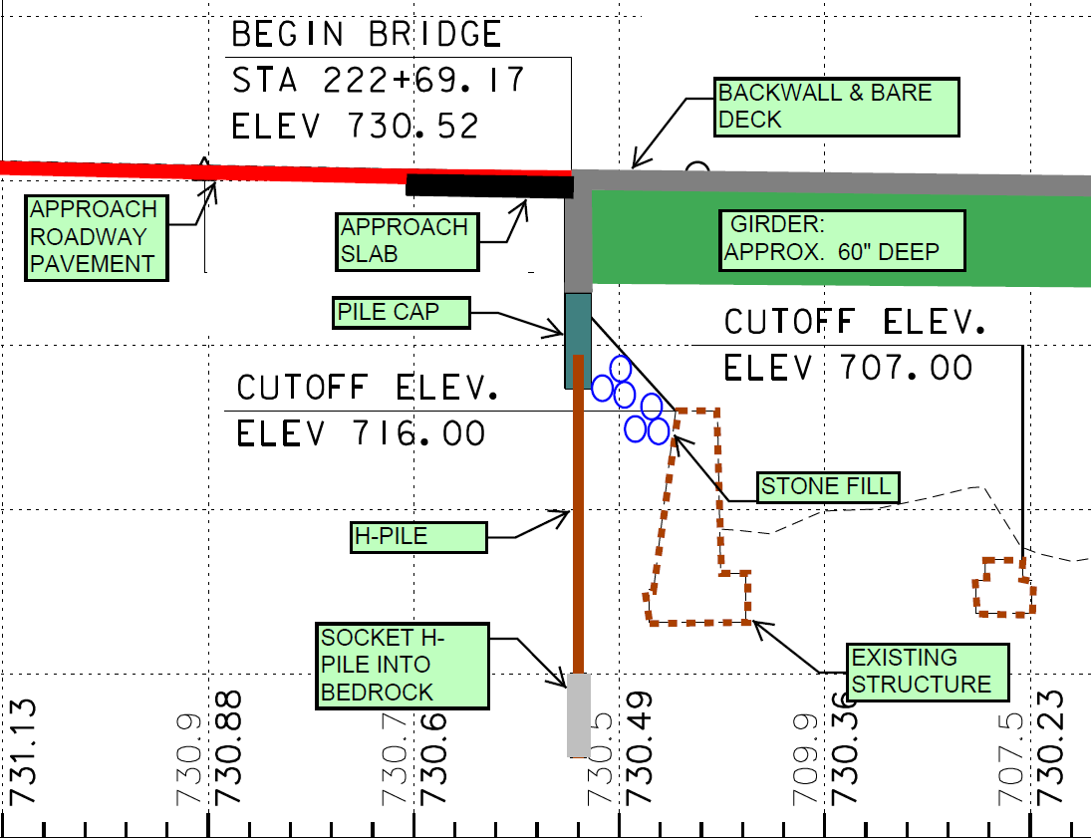
Removal of Existing Bridge & Proposed Bridge Components
Existing superstructure will be removed
Existing abutments will be partially removed / cut down to minimize excavation in the urban setting.
Bridge piers will be completely removed from the channel.

Slide 19
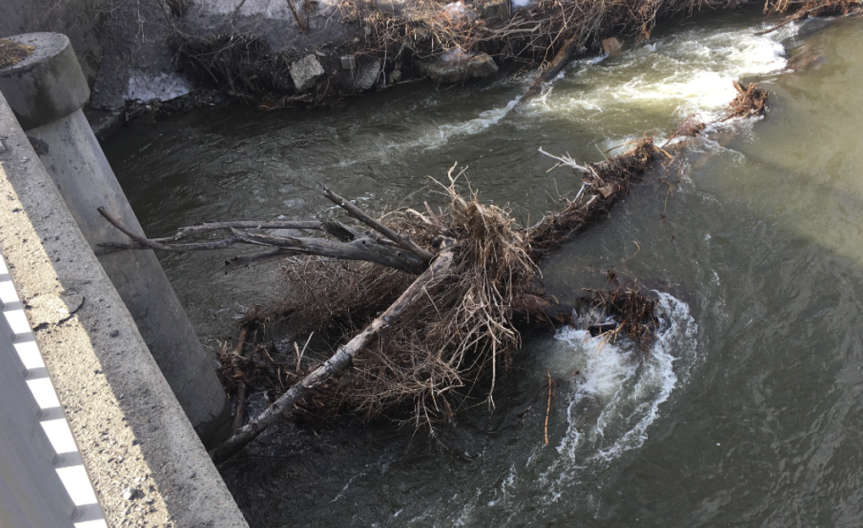
Hydraulics
  Proposed 140’ single span, integral abutment bridge improves hydraulic conditions
  Increased hydraulic Opening
  Removal of Piers:
  Eliminates Debris Concerns
  Decreases Scour Potential

Slide 20
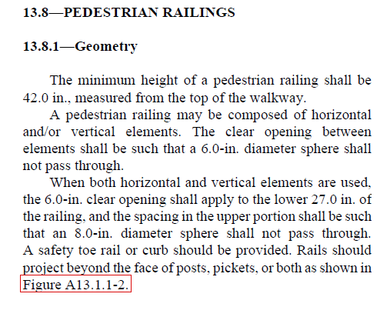
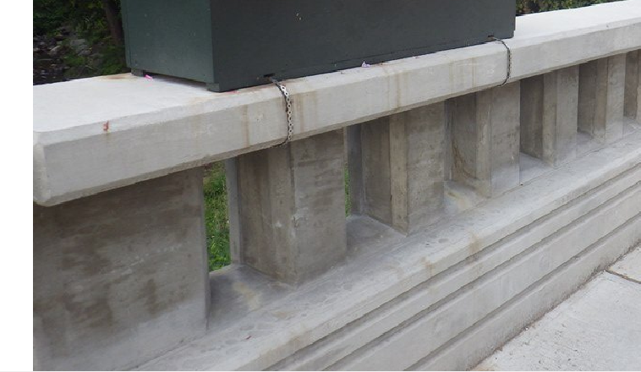
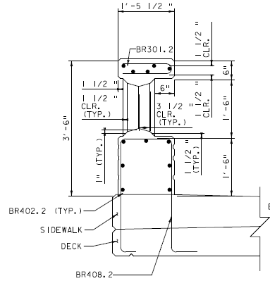
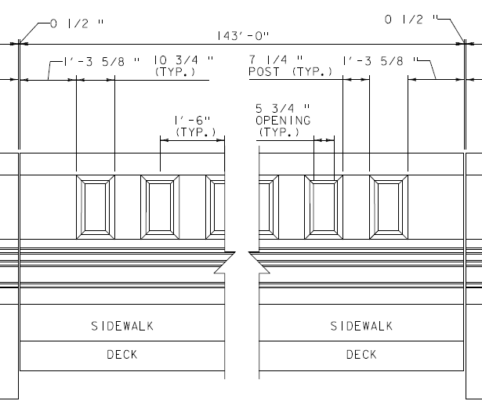
Design Characteristics
Bridge Railing

Slide 21
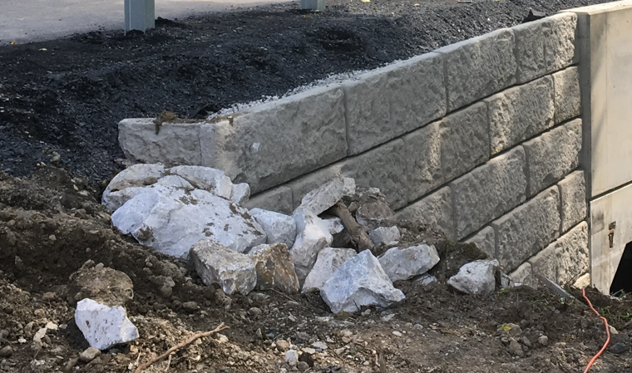
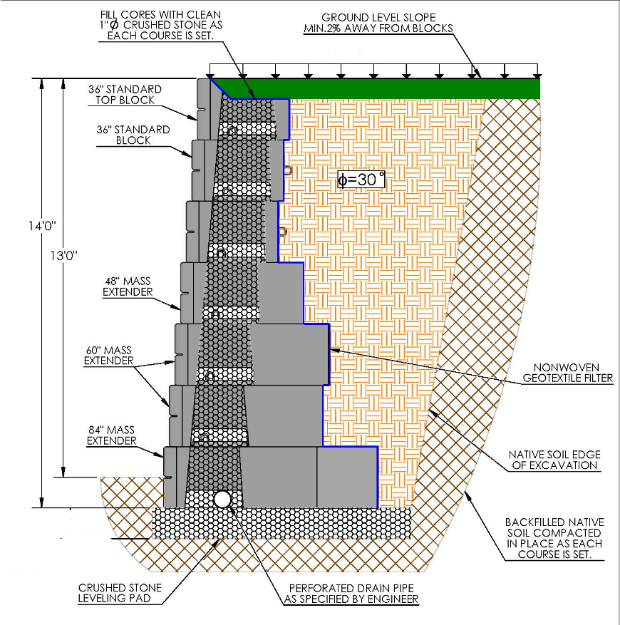
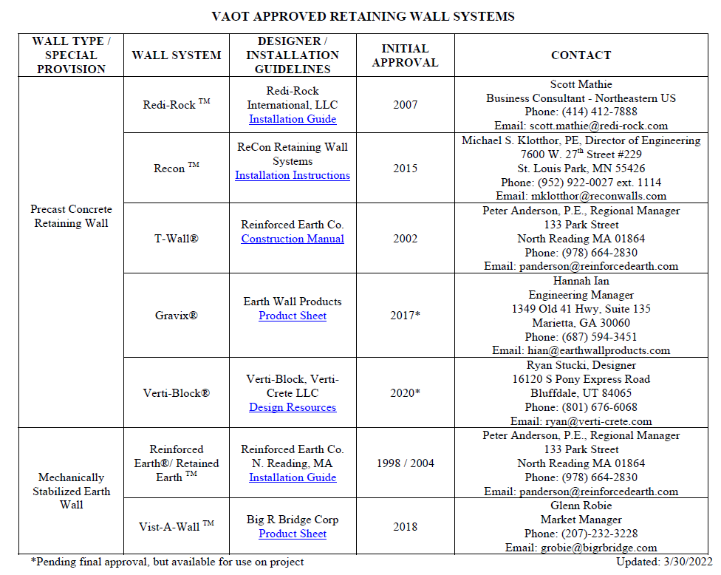
Substructure – Independent Retaining Walls (WW1, WW4)
Independent Retaining Walls will be utilized on the SW, NW, NE corners of the bridge.
Independent walls do not introduce torsional stresses on the substructure thus minimize the potential of concrete cracking during expansion and contraction of the bridge.
Precast Concrete Retaining Wall
VTrans Approved Retaining Wall Systems:
https://outside.vermont.gov/agency/VTRANS/external/docs/construction/03GeotechEng/Engineering/Approved%20Wall%20System%20List.pdf

Slide 22
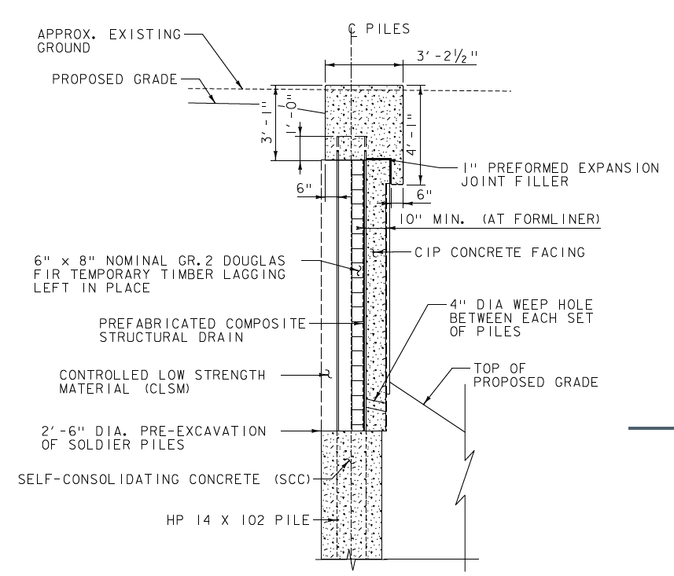
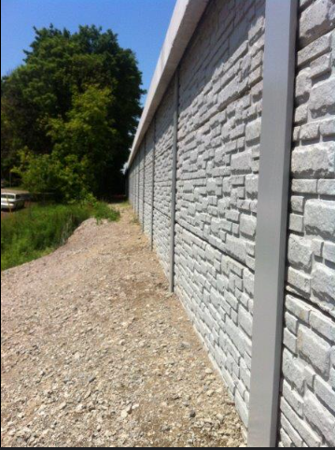
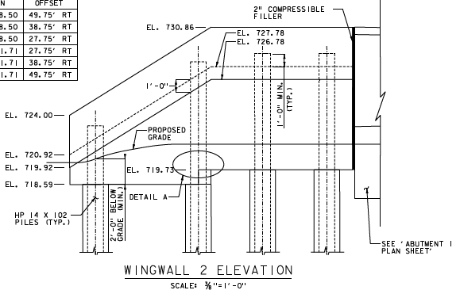
Substructure – Independent Retaining Walls (WW2, WW3)
Permanent Soldier Pile Retaining Wall (Drilled)
A concrete-faced soldier pile wall is a retaining wall system that utilizes steel H-shaped beams (soldier piles) driven or drilled into the ground at regular intervals, with a concrete facing (either cast-in-place or precast) installed to retain soil. This type of wall is often used for both temporary and permanent support of excavations, particularly in situations where a deep excavation is needed.
This wall type is required to minimize excavation limits on the Southeast and Northwest corners of the bridge to not impact impacting existing building foundations and utilities. This type of wall does not require reinforced earth behind it and will stand on its own if excavation is required behind it in the future to maintain municipal utilities, etc.

Slide 23
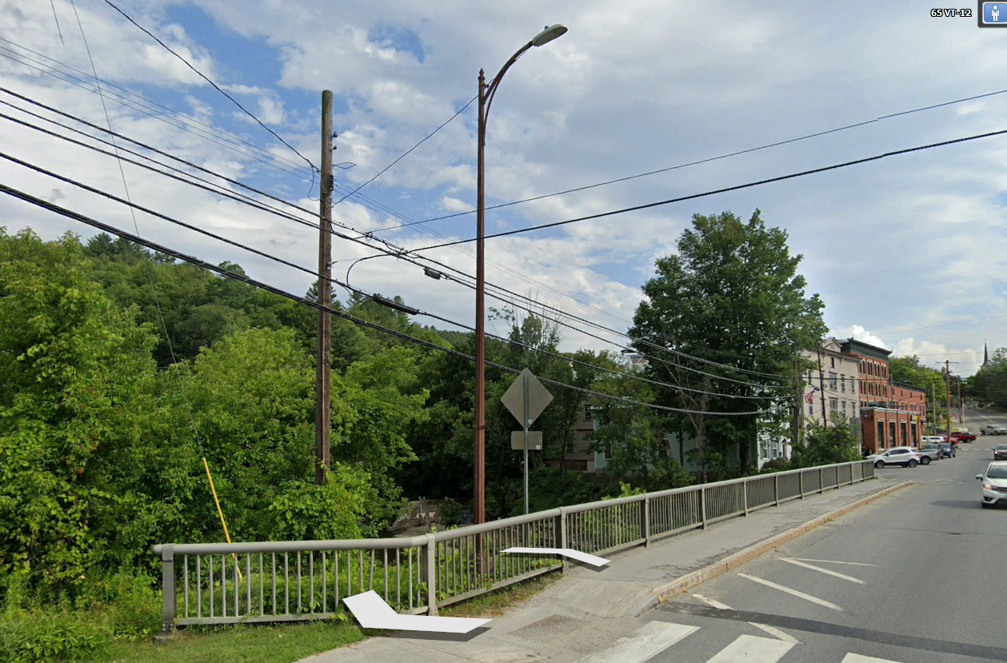
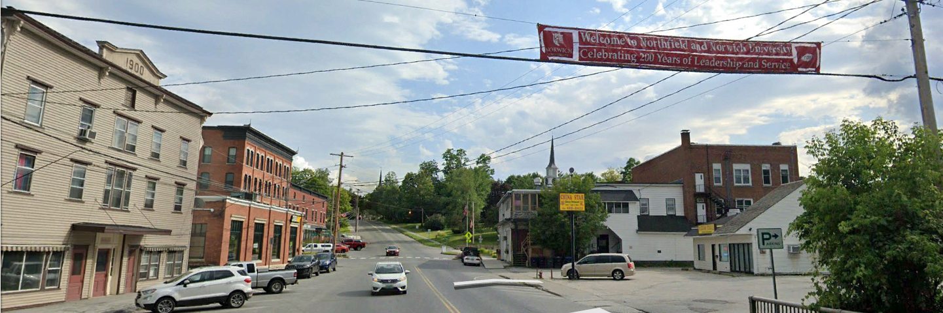
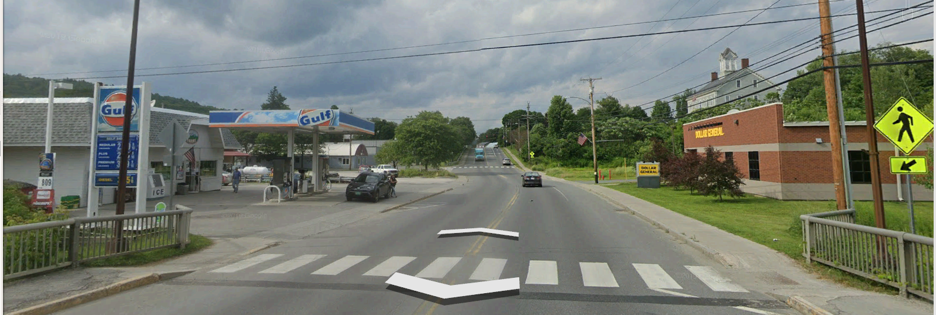
UTILITIES

Slide 24
Utility Relocation: Progress
Utility Relocations Underway:
Municipal Utilities:
  The Town of Northfield Water and Sewer Department has a waterline attached underneath the bridge.
  The Town of Northfield has street lighting on the 4 corners of the bridge.
Underground:
  Village of Northfield Electric Department has underground services.
Aerial:
  Northfield Electric – GMP Serving Electric Company
  TDS Telecom
  Trans Video
  FirstLight Fiber

Slide 25
Utility Relocation: Progress
Utility Agreements (STATE/TOWN): Executed agreements August 2025
Utility Relocation Order: Executed August 2025
    Relocation of overhead utility lines when underground conduits are complete.
Utility Clearance: August 14, 2025
Town Contractor (Dufrene Group and Hutchins) currently installing municipal water line and underground conduits south of the bridge .
Soil management requirements for bridge project also apply for underground utility work within bridge project limits. Soils are being managed in accordance with DEC approved Soil Management Plan.

Slide 26
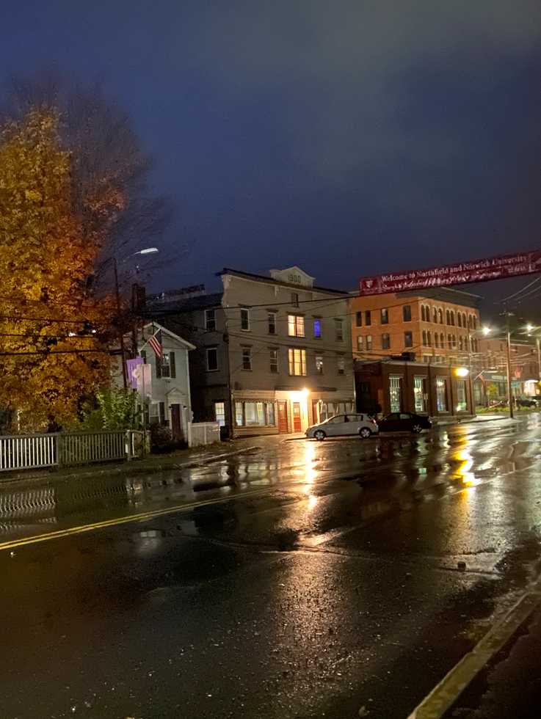
Bridge Lighting

Slide 27
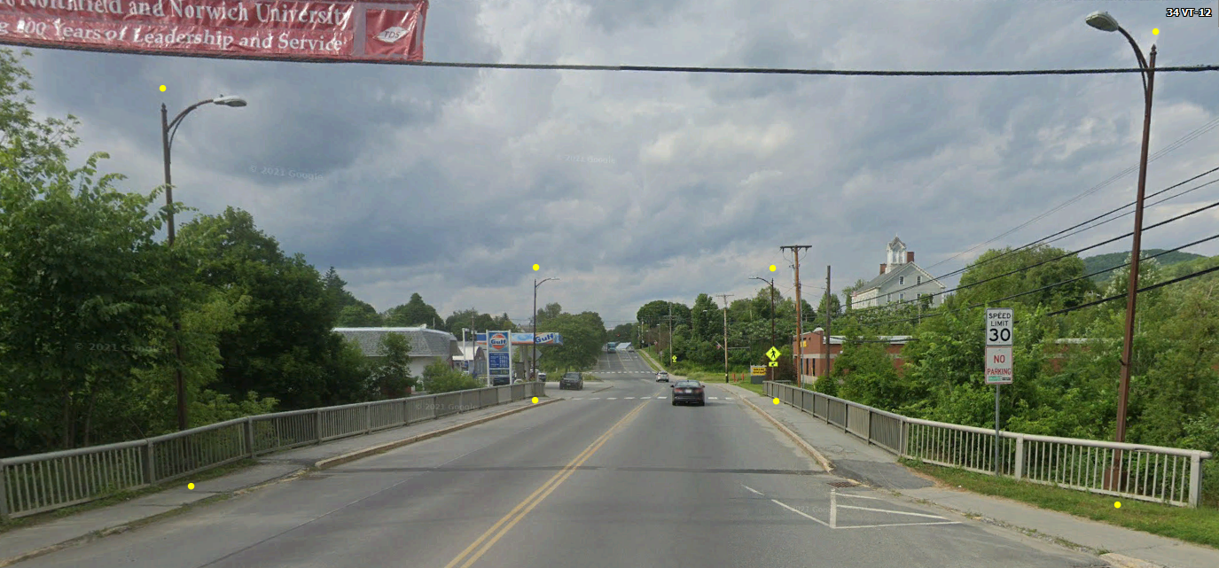
Existing Lighting
4 – Existing lights at each corner of the bridge
Existing lights not mounted to bridge

Slide 28
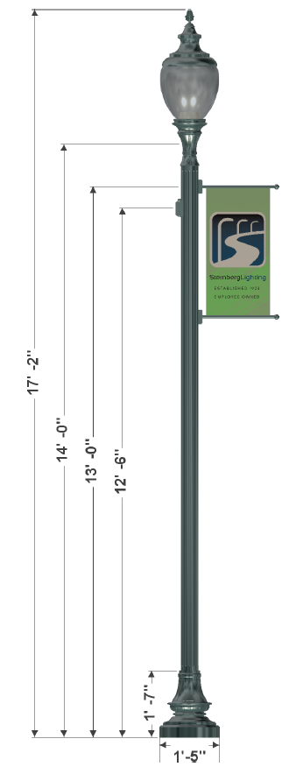
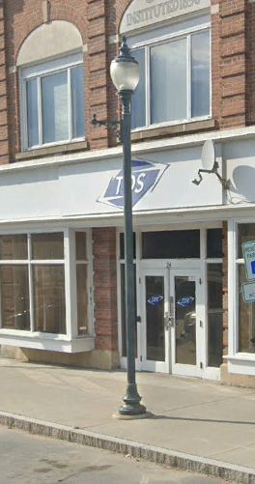
6 Proposed Poles
Proposed poles to match Depot Sq.
Height: 17’-2”
Pole Equipment
Banner Arm:
  48” in height.
  24” to 28” wide
Bottom Banner Arm approximately 10’ from sidewalk surface.
GFI Protected Receptacle

Slide 29
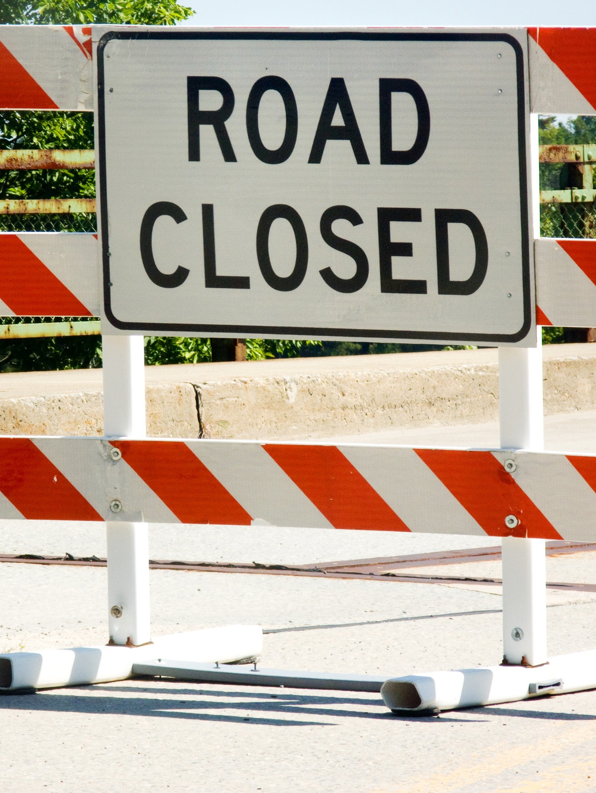
Maintenance of Traffic:
Bridge Closure Period
(Approximately 12-weeks)
  Detour chosen by Town and signed by State
  (Class 1 TH)
  Regional Detour:
      26.4-mile end-to-end
  Local Detour:
      0.8-mile end-to-end
      Railroad Crossing x 2

Slide 30
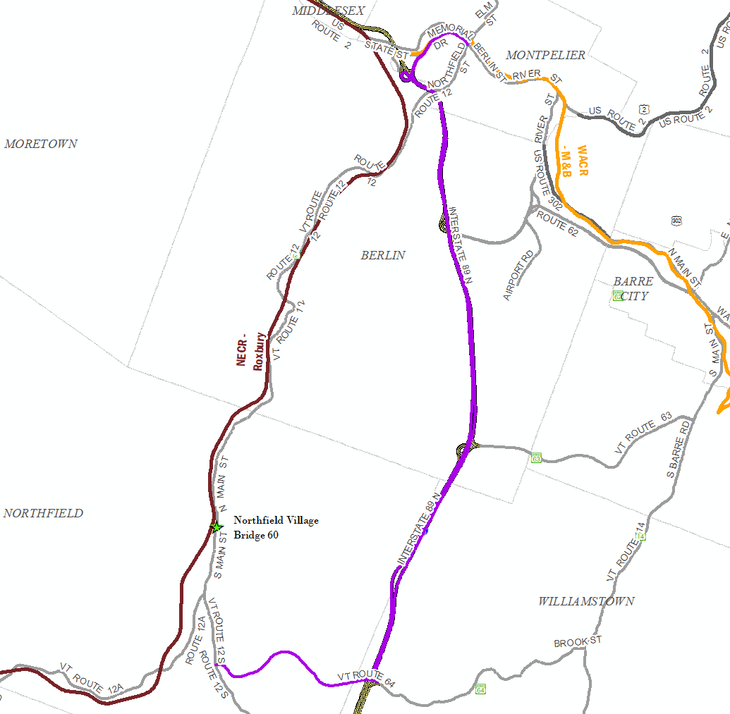
Traffic Control – Offsite/Regional Detour (Trucks)
  VT Route 12, to VT Route 64, Memorial Drive and Interstate 89, back to VT Route 12
  26.4 Miles end-to-end
  11.9 Miles Through-Route
  14.5 Miles Detour Route
  2.6 Miles Added

Slide 31
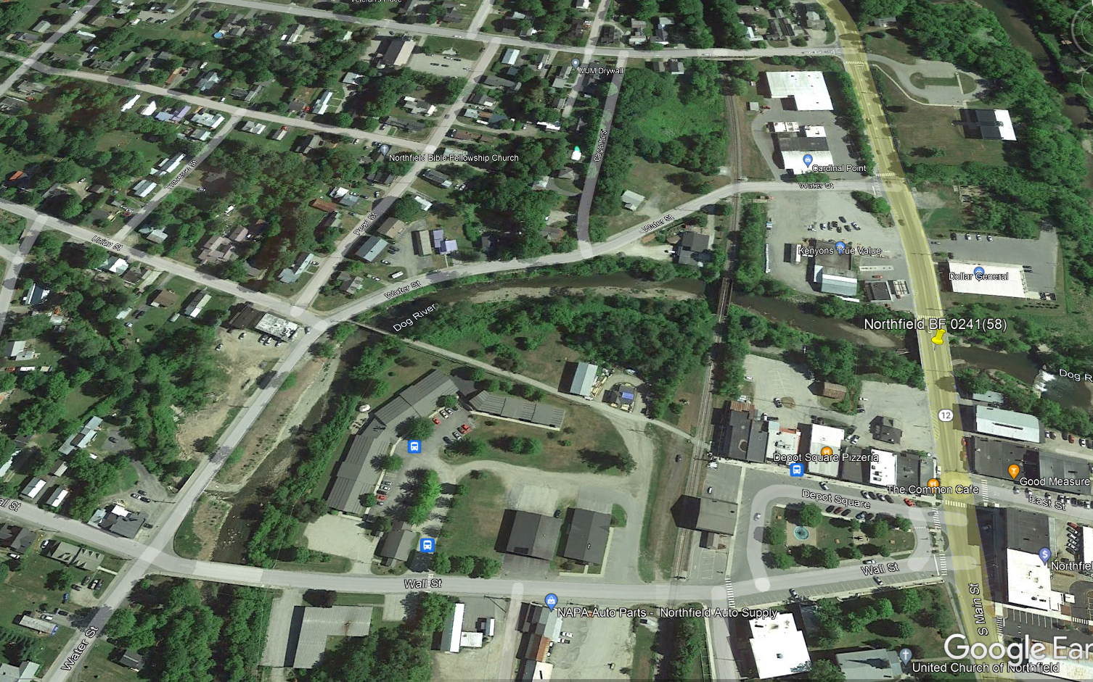
Traffic Control – Local Detour (Passenger Cars) & Pedestrian Detour
  VT Route 12 (North Main Street), to Water Street, and Wall Street back to VT Route 12 (South Main Street)
  February 2023: Board agreed Bike/Ped detour would follow the local detour
  0.8 Miles end-to-end
  0.2 Miles Through-Route
  0.6 Miles Detour Route
  0.4 Miles Added

Slide 32
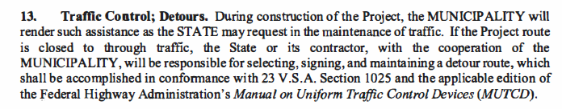
Finance & Maintenance Agreement:
Maintenance of Traffic
The bridge project is required to provide a temporary ADA accessible pedestrian detour route since the existing bridge has pedestrian facilities on the Class 1 Town Highway.
  In areas ADA compliance isn’t met with existing facilities on the designated route, the project will include appropriate channeling devices, and temporary surfaces, etc. on the designated route.

Slide 33
Finance & Maintenance Agreement:
Maintenance of Traffic
Nonparticipating Items: Pedestrian traffic measures that direct pedestrian traffic in directions other than the designated pedestrian detour route are nonparticipating to the project and will be the responsibility of the Town.
Temporary Work: The work along the local detour route is temporary in nature so all items installed except small areas we need to improve for accessibility like cross walk paint and paved areas for ramps / deteriorated sections of sidewalk for accessibility will be removed after we are finished with the detour.

Slide 34
Temporary Local Detour: Vehicles / Pedestrians
  Concerns expressed regarding safety of pedestrians at intersections
The local pedestrian detour sheets do not include the vehicular traffic signs, except for the area near Depot Square where wall street is changing configuration to accommodate two-way traffic.
  STOP at Wall St. / Depot Sq.
  STOP at Wall St. / Central St.
The bridge contractor will be required to submit a site-specific traffic control plan for the local vehicle detour and pedestrian detour that satisfies ADA requirements within their means and methods that meets the intent of the information provided.
  The pedestrian local detour route plan sheets have been included in the plans so the contractor may understand the scale of work required along the route for pedestrian accessibility for bidding the bridge project.
A VTrans Resident Engineer will be on site every day so adjustment can be made there are issues in the field.

Slide 35
Local Detour Intersections – STOP Condition
  Concerns expressed regarding safety at intersections
    Wall St. / Water Street
    Water Street / Union Street
  The bridge project is not proposing a stop condition change to what currently exists at the Wall St. / Water St. and Water St. / Union Street intersections.
  They Agency does not have jurisdiction to change these intersection conditions along the local detour route to install the stop signs since the Town is the governing entity of this local route.
  The Town of Northfield is the Governing body on local roads in accordance with 23 V.S.A. § 1008.
    If the board would like intersection conditions permanently changed to include an all stop at both intersections of Wall St. / Water St. and Water St. / Union Street the Town will need to create an ordinance.
  If the Town has ordinances for revised intersection conditions in advance of the bridge project construction and signs installed the project will include the necessary supplemental line striping along the local detour route.

Slide 36
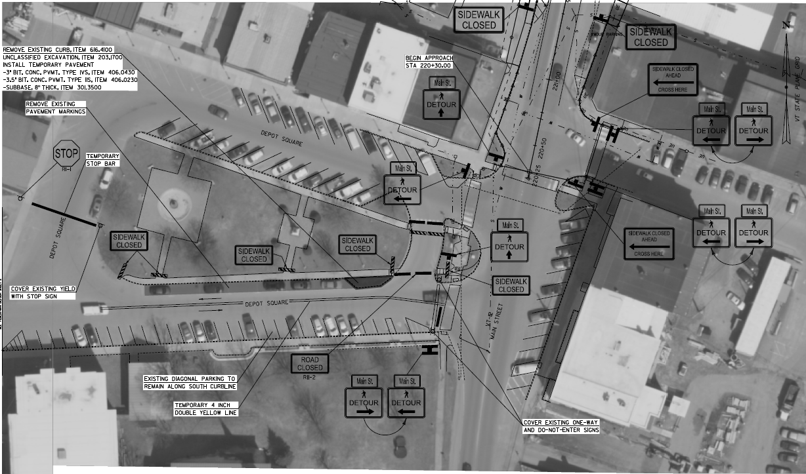

Traffic Control – Local Detour (Passenger Cars)
  VT Route 12 (North Main Street), to Water Street, and Wall Street back to VT Route 12 (South Main Street)
  Utilize 7 parking spaces along Wall Street for 2-way traffic flow during bridge closure period
  Turning movement reviewed indicate there is adequate space for two lanes of traffic with the proposed configuration.
  The intersection of Depot Square / Wall St. and Central St. / Wall St. are temporarily being changed from yield conditions to Stop conditions for safety in accordance with MUTCD.
  In addition to temporarily removing parallel parking, remove diagonal parking to provide more space / enhance safety? (Town owned?)

Slide 37
Traffic Control – Local Detour (Passenger Cars)
  VT Route 12 (North Main Street), to Water Street, and Wall Street back to VT Route 12 (South Main Street)
  Clarity of the pedestrian detour route:
  Pavement markings for the pedestrian detour route will be refreshed so the path of travel is clear.
  Pedestrian Route

Slide 38
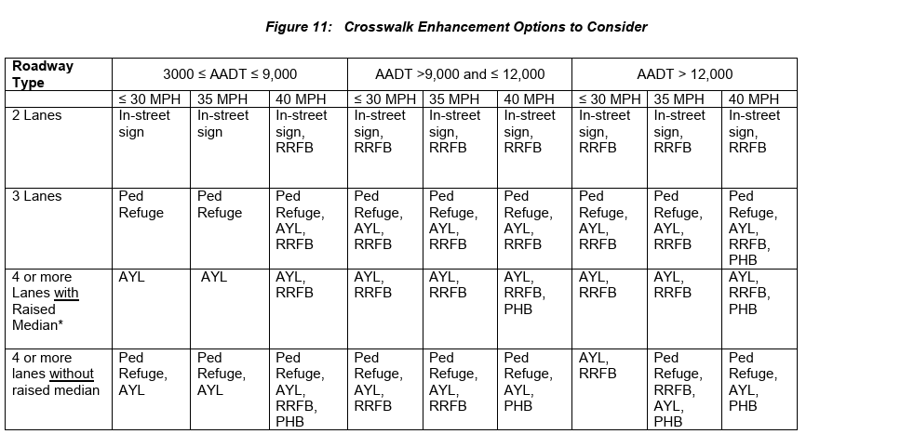
Traffic Control – Pedestrian Detour – Crosswalk Enhancement
  Pedestrian safety concerns along local detour route:
  2019 VTrans Guidelines for Pedestrian Crossing Treatments (Figure 11)
    VT12: ADT 4200 Crosswalk Enhancement Options
      In-street sign
      No temporary signals at crosswalks: Rectangular Rapid Flashing Beacons (RRFBs) or equivalent temporary signal

Slide 39
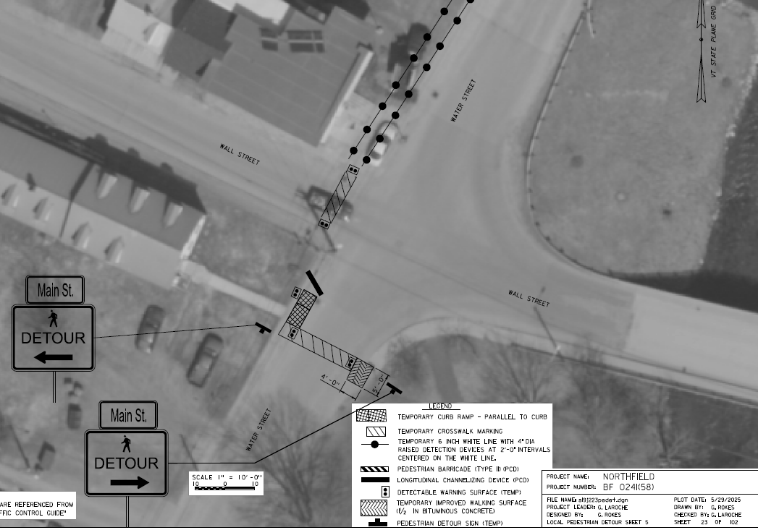
Intersections – Wall St. / Water Street
  Concerns expressed regarding safety of pedestrians at intersections
  Wall street has inter-block connectivity to pleasant St.
    For enhanced safety during bridge closure traffic on this leg of wall street could be closed
  For clarity of traffic flow a double yellow line could be striped at intersection of Wall and Water.
  Pedestrian Route Double Yellow Line
  Type III Barriers
  Existing STOP

Slide 40
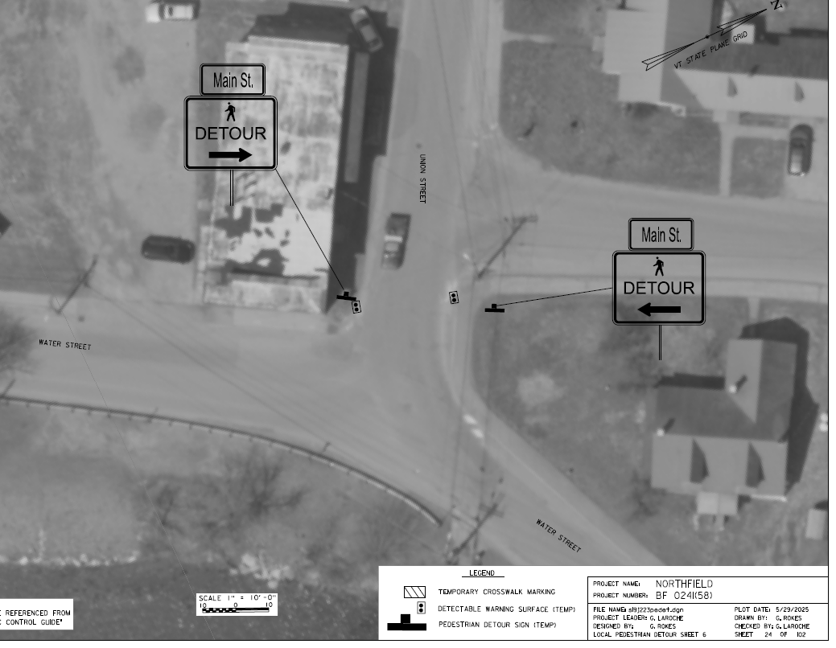
Intersections – Water St. / Union Street
  Concerns expressed regarding safety of pedestrians at intersections
  Wall street has inter-block connectivity to pleasant St.
    For enhanced safety during bridge closure traffic on this leg of wall street could be closed
  For clarity of traffic flow a double yellow line could be striped at intersection of Wall and Water.
  Pedestrian Route Double Yellow Line
  Existing Crosswalk to be restriped
  Existing STOP

Slide 41
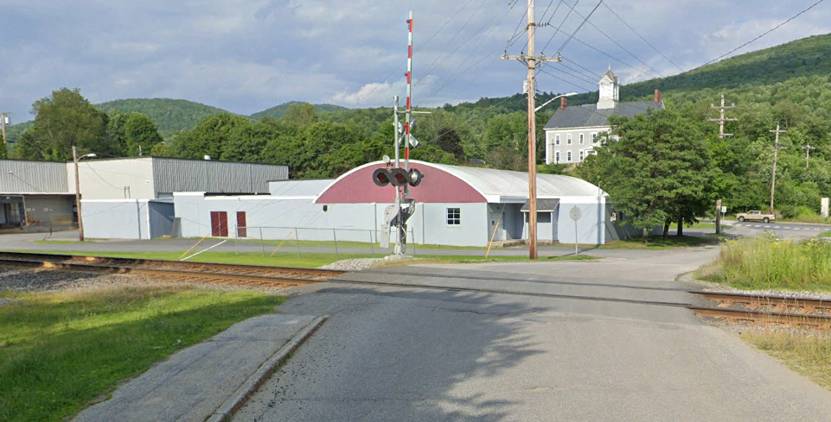

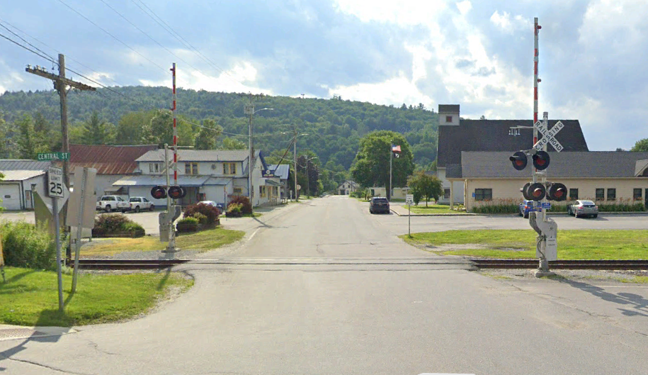
Railroad Crossing – VTrans / NECR Coordination
  The local vehicle and pedestrian detour will cross NECR in two locations
  Existing railroad pavement seals are considered ADA compliant. The project proposes to use the existing width of pavement and include channelizing devices through each RR crossing area.
  Right-of-Entry agreement: (This is essentially a permit to be in the ROW, and not going to disrupt anything) The intent of this agreement is for short duration non-impactful work within the railroad ROW. Right-of-entry agreement will include RR flagging hours.
  Wall St. ->Water St. (Local Vehicle / Pedestrian Detour)

Slide 42
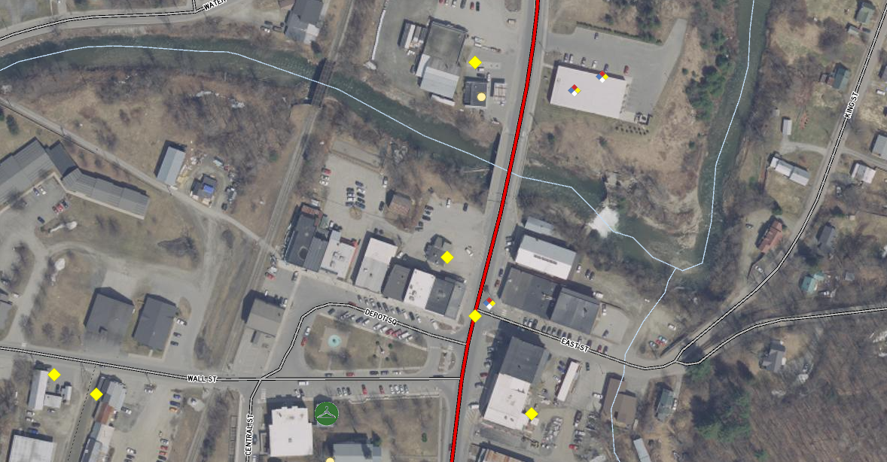
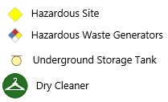
Finance and Maintenance Agreement: Environmental Contamination
Existing Conditions
Hazardous Sites (ANR ATLAS)
  Fernandez Living Trust (SW)
  Wesco Realty, LLC. (NW)
  Dollar General (NE)

Slide 43
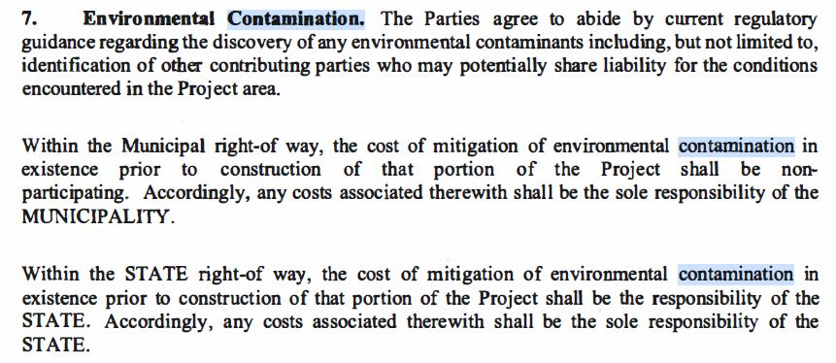
Finance & Maintenance Agreement & I-RULE

Slide 44
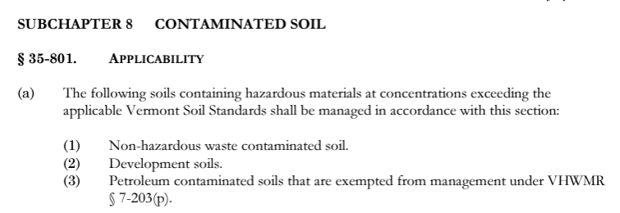
Vermont DEC I-Rule:
What are contaminated soils?
Vermont DEC I-Rule:
https://dec.vermont.gov/sites/dec/files/wmp/Sites/0706.IRULE_.pdf
100% Town Responsibility:
Development Soil Reuse/Disposal
Hazardous Soils Disposal
Environmental Professional Oversight

Slide 45
Soil Management Plan
ATLAS Environmental:
Soil Management Plan Scheduled for Completion 8/14/2025
For estimating, the project included $500,000 for soil disposal in the estimate assuming all soil excavated is contaminated and requires disposal.
  Petroleum Contaminated Soil disposal through petroleum cleanup fund(PCF) accounts for roughly $100,000 of the total estimate.
    As stewards to the taxpayer VTrans seeks the lowest cost alternatives by prioritizing what can be reused and what will be reimbursed by other entities.
  PCF applications have been filled out on behalf of the Town to dispose of this material and reimburse the Agency for nonparticipating cost.
  Soil will be tested after all soil in a decision unit has been excavated and prioritized for reuse to minimize disposal costs.

Slide 46
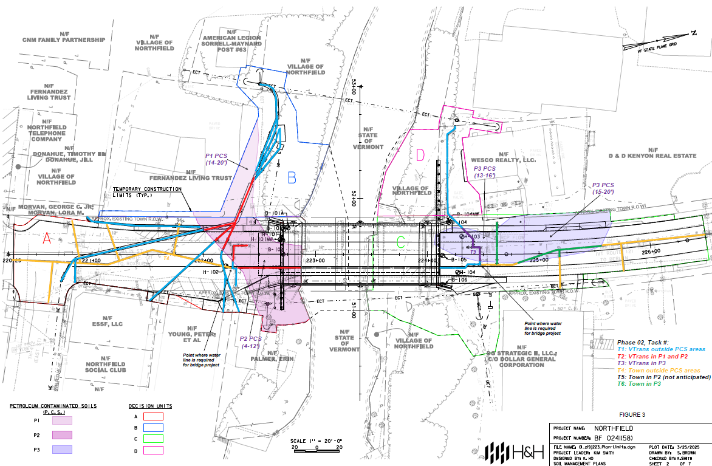
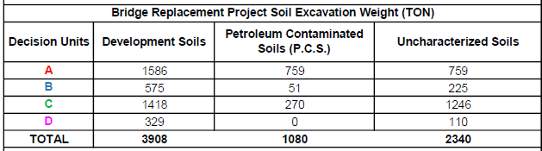
Soil Management Decision Units:

Slide 47
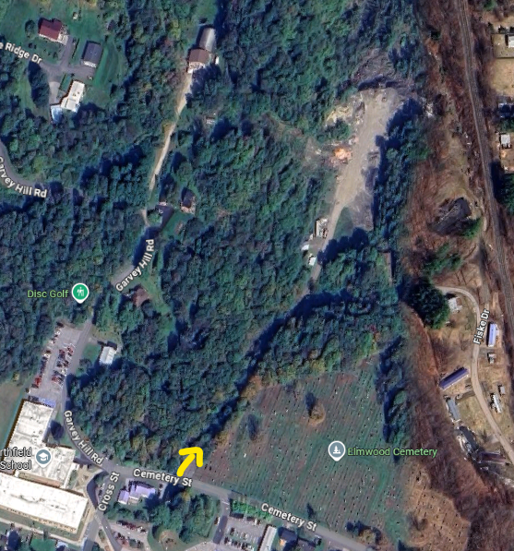
Soil Management Location
Soil will be managed at the Town owned sandpit:
Site approved for use by VT Department of Environmental Conservation (DEC)
Utility relocation this year (2025)
Bridge construction (2026)

Slide 48
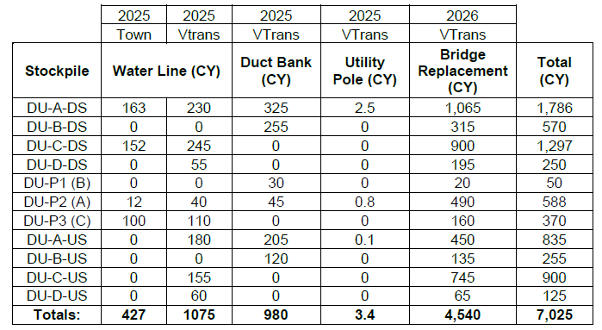


Vermont DEC I-Rule:
Soil Management Location

Slide 49

Vermont DEC I-Rule:
2025 Utility Construction
2025 Utility Relocation Soil Test Performed to Date:
  Decision Unit DU-A-US - 0 to 4 feet south of the bridge
    This location was within the roadway prism not within the area labeled as a petroleum impacted .
  Testing came back under within urban soil criteria so the Town may reuse this soil within the same urban background area defined by the ANR ATLAS.

Slide 50
Town Share: ACT 153 of the 2012 Legislative Session
 | Local Share
 | Road Closed During Construction | Road Open During Construction
Rehabilitation | 2.5% | 5%
Replacement | 5% | 10%
Per Act 153, the local share is reduced by 50% for rehabilitating versus replacement
Per Act 153, the local share is reduced by 50% for closing the road to traffic during construction

Slide 51
Total Cost Estimate
 | 2025 Final PS&E | Expended to Date | Town Share
Preliminary Engineering & ROW (5% Town) | $1,900,000.00 | $1,666,301.67 | $95,000.00
Construction w/ Engineering, Contingency, Misc. (5% Town) | $11,055,783.00 | $0.00 | $552,789.15
Soil Disposal (100% Town) | $500,000.00 | $0.00 | $500,000.00
TOTAL COST EST. | $13,455,783.00 |  | $647.789.15 + Soil Disposal

Slide 52
Previous Estimate Comparison
 | 2023 Preliminary Plans | 2025 Final PS&E | DELTA | % Difference
Preliminary Engineering & ROW (5% Town) | $935,000.00 | $1,900,000.00 | $965,000.00 | 203.2%
Construction (5% Town) | $7,982,000.00 | $11,055,783.00 | $3,073,783.00 | 38.5%
Soil Disposal (100% Town) | $0.00 | $500,000.00
TOTAL COST EST. | $8,917,000.00 | $13,455,783.00 | $4,538,783.00 | 50.9%

Slide 53
Estimate Explanation
    Preliminary Engineering:
    PE cost Increase is due to complexity of the project in an urban setting and the redesign efforts to assure the removal of the Cross Brothers Dam did not negatively impact the new bridge.
    Construction Estimate:
    Estimates have been based on current prices and not projected prices into the future since inflation rates have been unpredictable. Structural Steel prices have fluctuated greatly over the past several years.
    The municipal waterline on the bridge was not included in the Preliminary Plan estimate since DG hadn’t provided information at the time of submission.
    Cross Brothers Dam removal redesign
      Redesign of the foundation increased the length of piles and drilling for the deep foundation
    Contaminated soil disposal was not included in project estimate in 2023.
      Preliminary did not include 100% disposal/oversight cost of hazardous soil, but included $500,000 in estimate at Final Plans
    Soldier Pile wall type determined between Preliminary and Final Plans: This type of wall is more costly than other types of retaining walls due to the drilling required to install the piles.

Slide 54
Project Schedule
Environmental Permits: Cleared
Right of Way: Cleared
Utilities: Clearing August 14, 2025
Contract Plans: August 14, 2025
Advertise for Construction: September 10, 2025
Construction Start: April 1, 2026

Slide 55

Construction Schedule
Pre Bridge Closure: April 1, 2026 – May 31, 2026
Prior to the bridge closure the Contractor will be allowed to maintain a minimum of one-lane (12-foot lane and two 2-foot shoulders) alternating traffic during daytime hours to perform work. No night work will be allowed during this time, and two-lane, two-way traffic must be maintained on the existing alignment during nighttime hours.
Access to channel / causeway
Soil management area
Subsurface utility relocation – Kenyon waterline
WW2 & WW3 Soldier Pile Walls
Bridge H-Pile Drilling / Installation

Slide 56
Construction Schedule
Bridge Closure: June 1, 2026 – August 28, 2026
Bridge deck, bridge sidewalk, bridge rail, and approach slabs cast
base and intermediate course of pavement shall be placed and compacted through the project limits. Temporary pavement transverse tapers shall be installed at the begin and end of bridge deck, and at the existing pavement match locations.
Wingwalls #1, #2, #3, and #4 shall be installed and backfilled.
Construction of the portion of proposed water main that is supported by the superstructure.
Restore Depot Square to original motor vehicle traffic flow configuration.
The bridge and roadway shall be opened to two-way traffic (two 12-foot lanes and two 2-foot shoulders) with temporary delineation.

Slide 57
Construction Schedule
Post Bridge Closure: - August 29, 2026 - October 15, 2026
channel access removal
Approach roadway: Finish sidewalk, wearing course pavement on bridge approaches,
Line striping
Site cleanup
Project completion: October 15, 2026

Slide 58


Concurrent Construction Risk
Cross Brothers Dam Removal project scheduled for construction in 2026?
Overlapping project limits creates risk of construction delay claims by the contractor(s). VTrans does not recommend these projects occur at the same time especially when the bridge is closed for 12-weeks.
Cross Brothers Dam Project Layout
Bridge Project Construction Layout

Slide 59
VTrans Revenue Forecast
Developments 8/12/2025 at 5PM: Due to the budget revenue forecast there is possibility of revenue downgrades. Meaning, this would require the bridge project to be pushed out due to lack of funding.
We will understand the revenue picture more in the next few weeks and I will be in communication with the Town with updates.
I am moving forward with the project as if the project is going to Advertise on September 10, 2026, until I hear otherwise.

Slide 60

Northfield Village BF 0241(58)
Questions and Comments
Vermont Route 12 – Bridge #60 over Dog River
For more information:
https://outside.vermont.gov/agency/vtrans/external/Projects/Structures/19J223
August 12, 2025

